Slide 1
Welcome To English Class

Slide 2
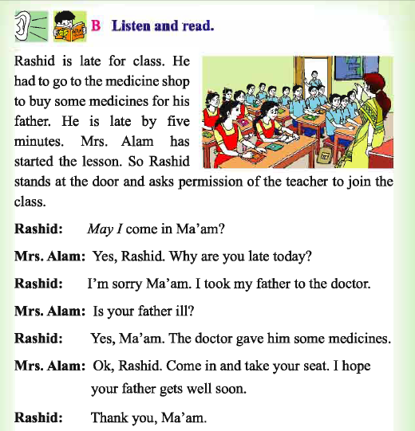
Introductions:
Teachers Identity
Nizam Uddin Jewel
Assistant Teacher
Bahercor gov.primary school
Raipura,Narsingdi
E-mail: nizamuddinjewel@gmail.com
Mobile: 01814902195
72

Slide 3
Lets watch a video clip

Slide 4
Todays Lesson
Lesson:20
Unit: B Listen and read.
Page: 72
72

Slide 5
Learning Outcomes:
Students will be able to :
take part in conversations on appropriate topics.

Slide 6
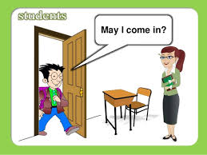
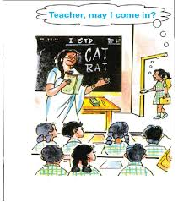
Look very attentively:
What are the students doing in these pictures?
They are asking permission to come in to the class.

Slide 7
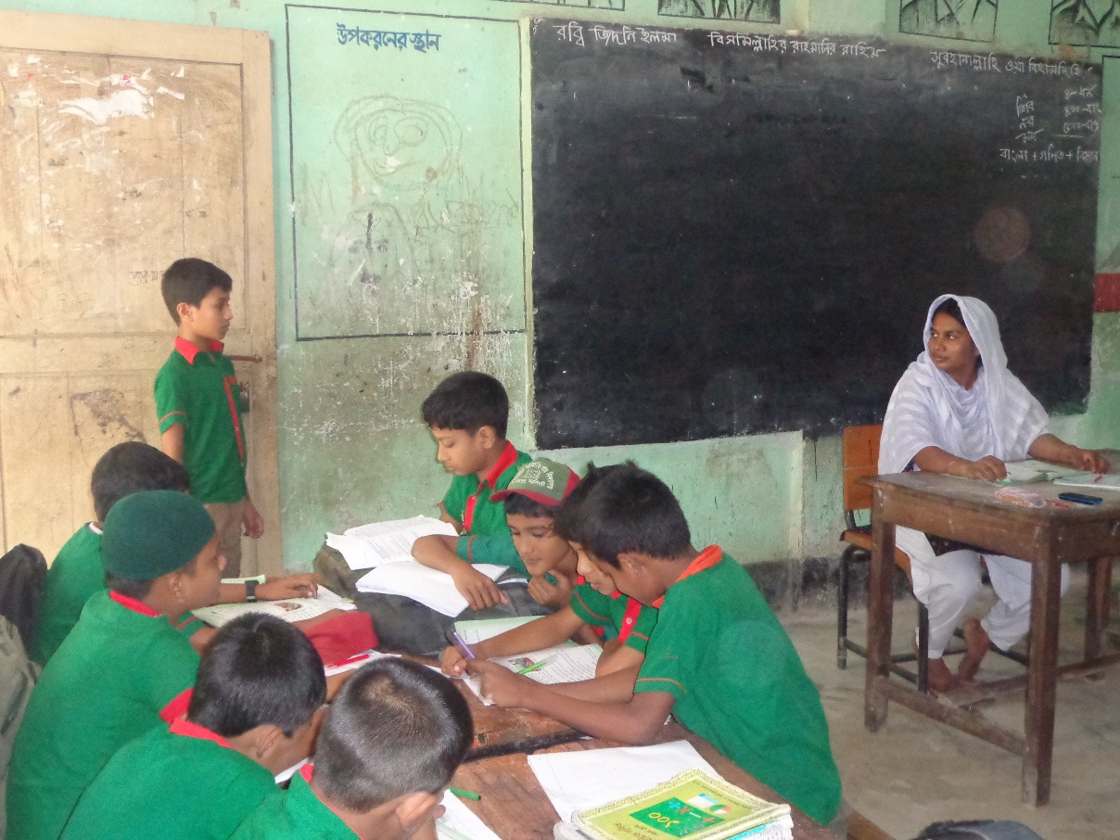
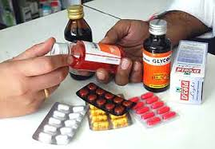
Rashid
Mrs. Alam has started the lesson. So Rashid stand at the door and asks permission of the teacher to join the class.
May I come in Ma’am?
Mrs. Alam
Rashid is late for class.
He had to go to the medicine shop to buy some medicines for his father.

Slide 8
Todays lesson
May I Help You?
Class:5
Sub: English
Pre:ss:43
Date:13 june2015
Yes, Rashid. Why are you late today?
Rashid
May I come in Ma’am?

Slide 9
Todays lesson
May I Help You?
Class:5
Sub: English
Pre:ss:43
Date:13 june2015
Ok , Rashid. Take your seat. I hope your father gets well soon.
Is your father ill?
Thank you, Ma’am.
I’m sorry Ma’am. I took my father to the doctor.
Yes, Ma’am. The doctor gave him some medicines

Slide 10
Individual work
Arrange and rewrite the following words so that they make sense.
Click here for Question
Click here for Answer
1. dicimene
1. medicine
2. come,in,ma’am,may,i?
2. May I come in ma’am?
3. today,late,why,are,you?
3.Why are you late today?
4. ill,your,is,father?
4. Is your father ill?
5.in,come,take,and,sit,your
5. Come in and take your seat.

Slide 11
Pair work
Two students will make a pair. They will come in front of the class and make the dialogue about Mrs. Alam and Rashid.

Slide 12
Group work
Six students make a group and try to answer the following questions . group leader will present the group work.
Where is Rashid waiting?
2) Why Rashid waiting at the door?
3) Explain, why does Rashid late for his class?

Slide 13
Rewrite using capital letter and punctuation marks.
1. ay come in ma’am
es ashid hy are you late today
3. s your father ill
4. es ma’am
5. k ashid ome in
m
i
M
I
?
y
r
w
Y
,
R
.
W
?
i
?
I
y
,
.
Y
o
r
c
O
R
.
C
.

Slide 14
WCW
Match the words in column A with their meaning in column B.
A | B
1. Late | I. Near the end of a period time.
2. stand | Ii. To be in a vertical position.
3. come | iii. To move to a person or place.
4. hope | iv. to want something.
5. join | v. To fix two or more things together.
A | B
1. Late | I. To want something.
2. stand | ii. To fix two or more things together.
3. come | iii. To be in a vertical position.
4. hope | iv. To move to a person or place.
5. join | v. usually.
 | vi. Near the end of a period of time.

Slide 15
Evaluation
1. What’s the name of ma’am?
Joynob
Happy
Champa
Mrs. Alam
2.Rashid bought medicine for his……
brother
father
mother
sister

Slide 16
Evaluation
3. Who is Mrs. Alam?
Rashid’s mother
Rashid’s sister
Rashid’s aunt
Rashid’s teacher
4. How much time does Rashid late?
One minute
Five minutes
Two minutes
Six minutes

Slide 17
Evaluation
5. What class does Rasid read in?
Class one
Class four
Class two
Class five
6. Why is Rasid waiting at the door?
For order
For permission
For command
For request

Slide 18
Home work
Suppose you are Rashid. You want to buy medicine from medicine shop. Now practice a dialogue with your father.
Rashid

